Slide 1


School of Computer Science & IT Department of BCA
INTRODUCTION TO LINUX(20BCA1C06)
MODULE 2: The UNIX File System
Faculty : Dr. Ananta Ojha

Slide 2
Session -2
Directories
Conversion of path name to Inode Number

Slide 3
Directories
A directory is a file
It gives hierarchical structure to the file system
Play an important role in conversion of a file name to an inode number
Its data is a sequence of entries, each consisting of an inode number and the name of a file (or subdirectory) contained in the directory
A path name is a null terminated character string divided into separate components by the slash ("/") character.
Each component except the last must be the name of a directory, but the last component may be a non-directory file.
UNIX System V restricts
a maximum of 14 characters for a component name;
a 2 byte entry for the inode number,
the size of a directory entry is 16 bytes.

Slide 4
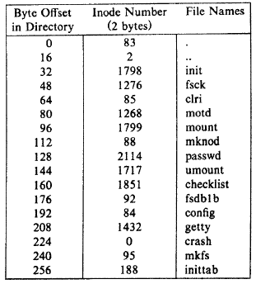
Directory Entry for /etc
Every directory contains the file names dot and dot-dot ("." and "..") whose inode numbers are those of the directory and its parent directory, respectively.
Directory entries may be empty, indicated by an inode number of 0.(i.e. deleted files).
The kernel stores data for a directory just as it stores data for an ordinary file, using the inode structure and levels of direct and indirect blocks.
Processes may read directories in the same way they read regular files, but the kernel reserves exclusive right to write a directory (via system calls), thus ensuring its correct structure.
The access permissions of a directory have the following meaning:
read permission on a directory allows a process to read a directory;
write permission allows a process to create new directory entries or remove old ones, thereby altering the contents of the directory;
execute permission allows a process to search the directory for a file name.

Slide 5
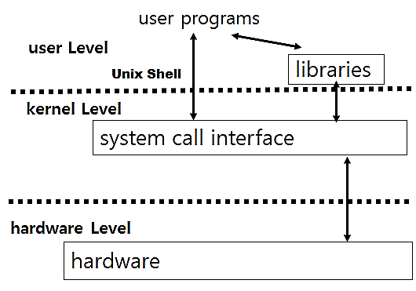
Conversion of Path Name to an Inode Number
The initial access to a file is by its path name, as in the open, chdir (change directory), or link system calls.
Because the kernel works internally with inodes rather than with path names, it converts the path names to inodes to access files.
The algorithm namei parses the path name one component at a time, converting each component into an inode based on its name and the directory being searched, and eventually returns the inode of the input path name.
All path name searches start from the current directory of the process unless the path name starts with the slash (‘/’) character, signifying that the search should start from the root directory.

Slide 6

Algorithm: namei
Here, working inode is used for the intermediate inodes in the path.
Input: path name; Output: inode number
{
if (path name starts with root)
working inode = root inode
else
working inode = current directory inode
while (there is more component in path name) {
read next component from input and verifies that working inode is of directory, access permissions OK
If (working inode is of root and component is ‘..’)
continue to check whether there is more path name or not
else
read directory entry to find the path name component
if (component matches an entry in directory)
get inode number for matched component
working inode = inode of matched component
else
return no inode i.e. component not in the directory
}
return (working inode)
}

Slide 7

THANK YOU Any questions…?

